Slide 1
Day 40 – Optimization Problems in Data Science & Machine Learning
Why Are We Learning Optimization?¶
Q) We often ask: " why are we learning all this calculus?"
Answer: Machine Learning is nothing but reducing mistakes step by step.
Every ML model:
Makes a prediction
Measures how wrong it is
Tries to reduce that wrongness
This process of reducing error is called Optimization.
👉 If optimization fails, ML fails.

Slide 2
What is Optimization?
Definition:¶
Optimization means finding the best possible value of something under given conditions.
In Data Science:
Best model
Lowest error
Highest accuracy
Optimization = Making the model as good as possible.

Slide 3
Optimization Difference between 2 modes
Optimization in Simple Real Life
Examples:
Choosing the fastest route on Google Maps
Buying the cheapest flight ticket
Studying minimum hours for maximum marks
All these are optimization problems.
Optimization in Machine Learning
In ML, we want:
Minimum error
Minimum loss
Minimum cost
The model learns by adjusting its parameters to reduce cost.

Slide 4
Important Terminology (VERY IMPORTANT)¶
Before optimization, we must clearly understand these terms:
Error
Loss
Cost
Many of us get confused here
Error
Example:
Actual salary = 50,000
Predicted salary = 45,000
Error = 5,000
Error tells how wrong one prediction is.
Loss Function
Loss is the error calculated for one single data point.
Examples:
Error for one student
Error for one house
Error for one image
Loss answers: "How wrong is the model for THIS data point?"

Slide 5
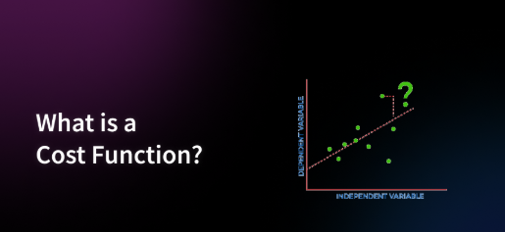
Cost Function¶
Definition
A Cost Function measures how far the predicted value is from the actual value.
Formula Idea
Cost = Error between Prediction and Actual Value
Goal of Model
👉 Minimize Cost 👉 Improve Accuracy
Simple Meaning
Cost Function = Penalty for Wrong Prediction

Slide 6
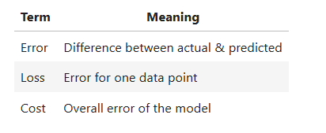
Relationship Summary¶
Remember: ML optimizes the COST, not single errors.

Slide 7
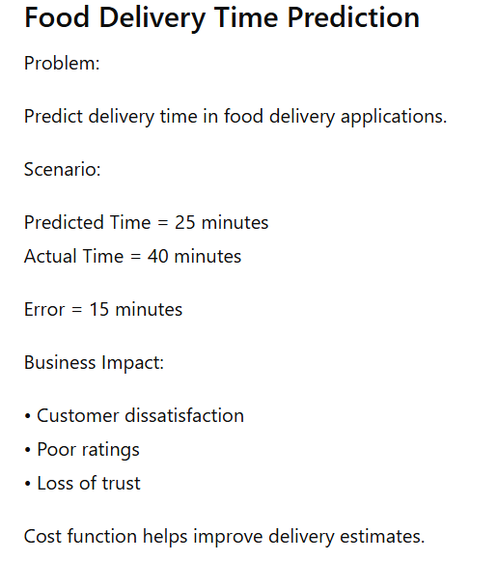
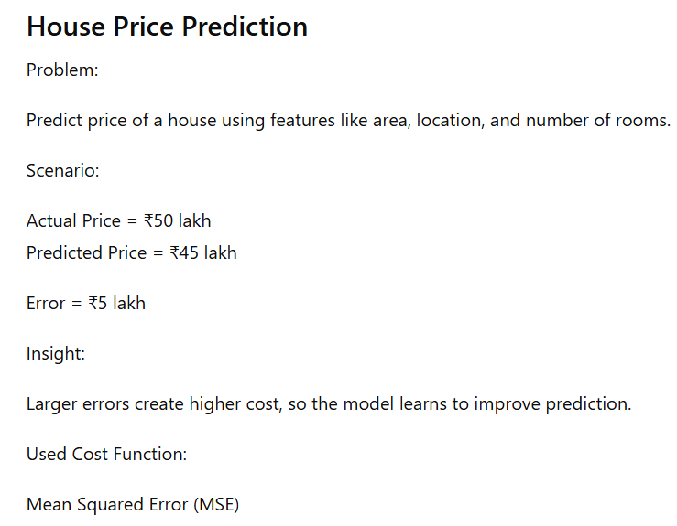
Examples of cost function and its affect

Slide 8
Optimization Using Derivatives¶
From calculus:
At the point where a function is minimum or maximum, its derivative is zero.
Machine Learning uses derivatives to:
Find where error is lowest
Stop learning at the best point

Slide 9
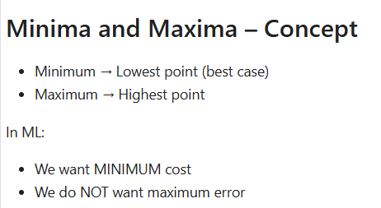

Slide 10
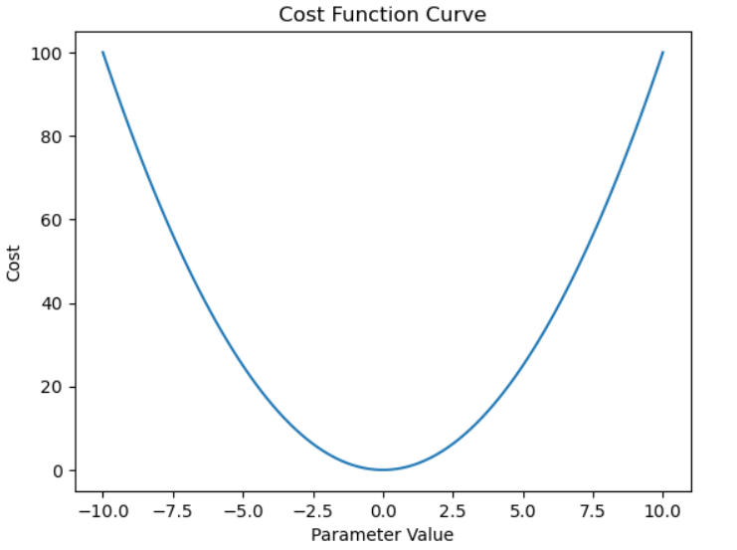
Example Cost Function Practically
Let cost function be:
Cost = x²
This represents how error changes with parameter x.
This function always gives positive values and has one minimum point.
import NumPy as np
import matplotlib.pyplot as plt
x = np.linspace(-10, 10, 100)
cost = x**2
plt.plot(x, cost)
plt.xlabel("Parameter Value")
plt.ylabel("Cost")
plt.title("Cost Function Curve")
plt.show()
CODE:

Slide 11
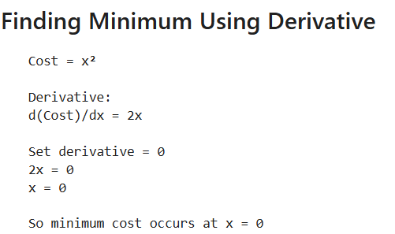
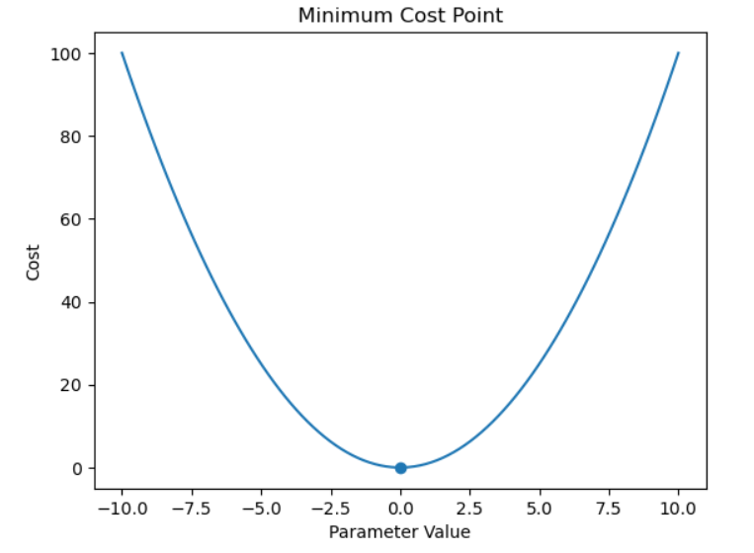
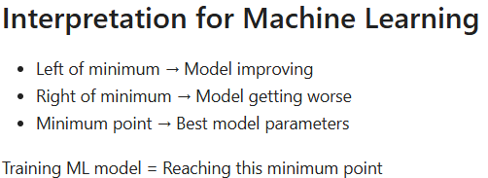
CODE:
plt.plot(x, cost)
plt.scatter(0, 0)
plt.xlabel("Parameter Value")
plt.ylabel("Cost")
plt.title("Minimum Cost Point")
plt.show()

Slide 12
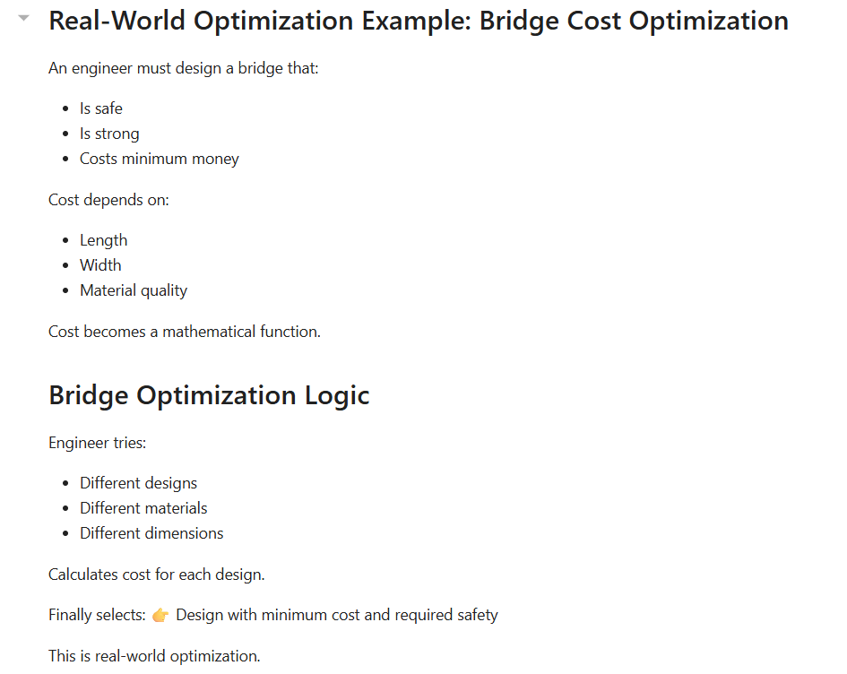


Slide 13
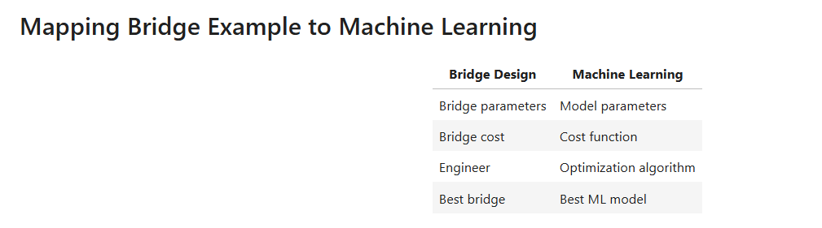

Slide 14
